Slide 1

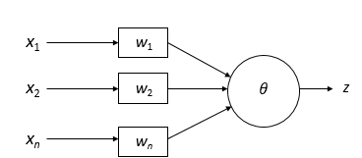
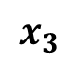
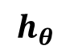
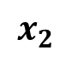
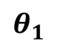
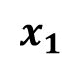
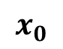
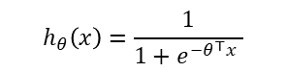
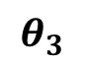

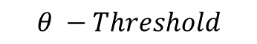
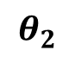
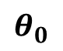
Perceptron
Works as a linear binary classifier (a threshold function which put positive outputs into one class & negative ones in other class)
Technically, logistic regression is a neural network with only 1 neuron
$$θ −Threshold$$
$$x_{0}$$
$$θ_{0}$$
$$h_{θ}\left(x\right)=\frac{1}{1+e^{−θ^{⊤}x} }$$
Multi-layer perceptron
$$x_{1}$$
$$θ_{1}$$
$$x_{2}$$
$$θ_{2}$$
$$h_{θ}$$
$$x_{3}$$
$$θ_{3}$$
Nueron
Perceptron Learning Algorithm – Training Instance
x₁
x₂
t
.8
.4
.4
.4
.8
.3
1
.3
.1
Z=1
.1
.1
Z=1
-.2
(as 0.26 >0.1)
-.2
(as 0.14 >0.1)
.4
.1
0
net = .8*.3 + .3*-.2 = .26
net = .4*.4 + .1*-.2 = .14

Slide 2
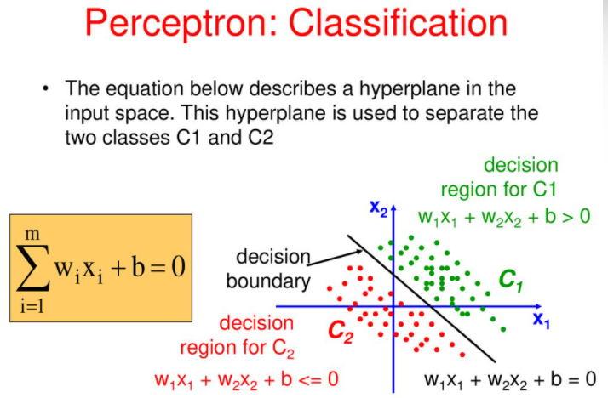
Decision Boundary : wTx + b = 0
bias determines the position of the boundary

Slide 3
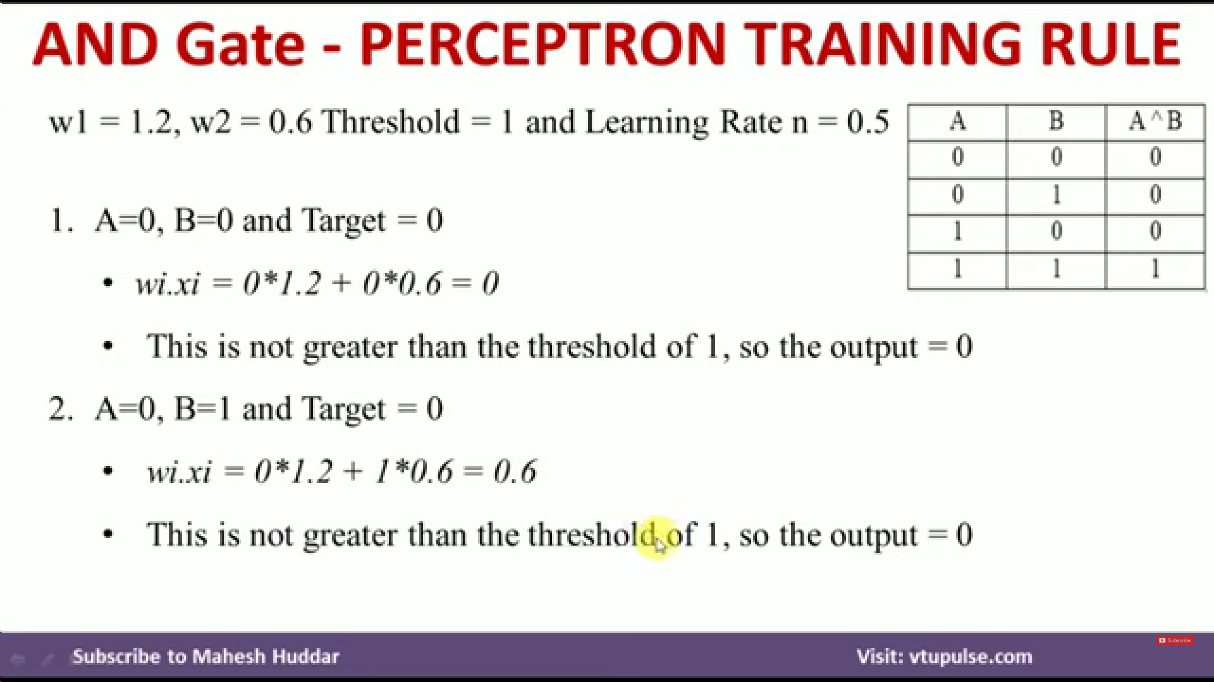
Since calculated value = target value, no change in parameters needed

Slide 4
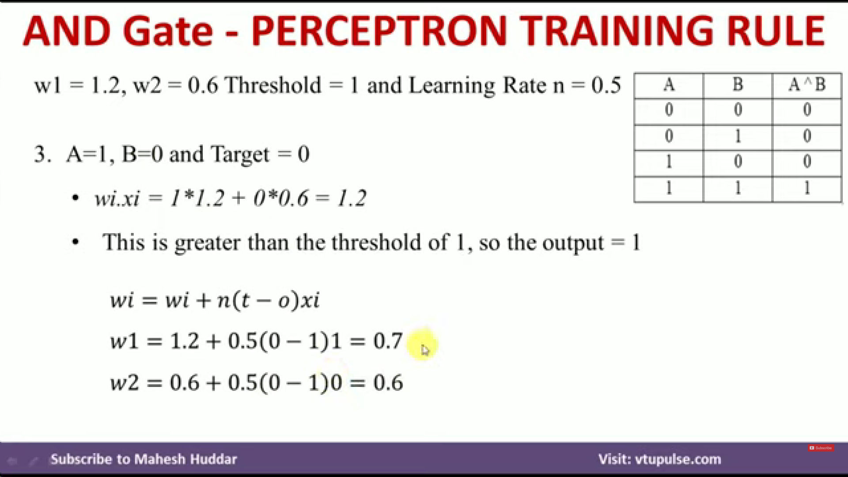
Since calculated value != target value, change in parameters needed
And you need to start from beginning again i.e A =0, B=0 with new weights

Slide 5
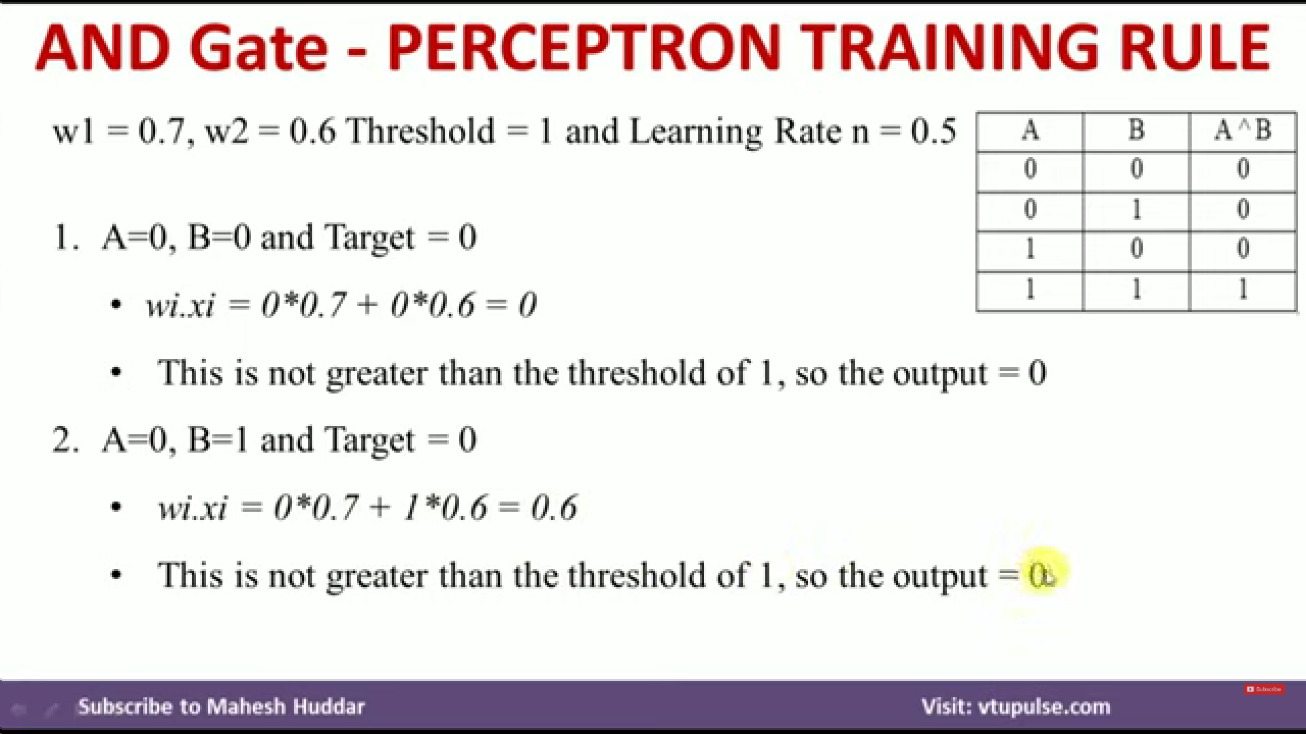

Slide 6
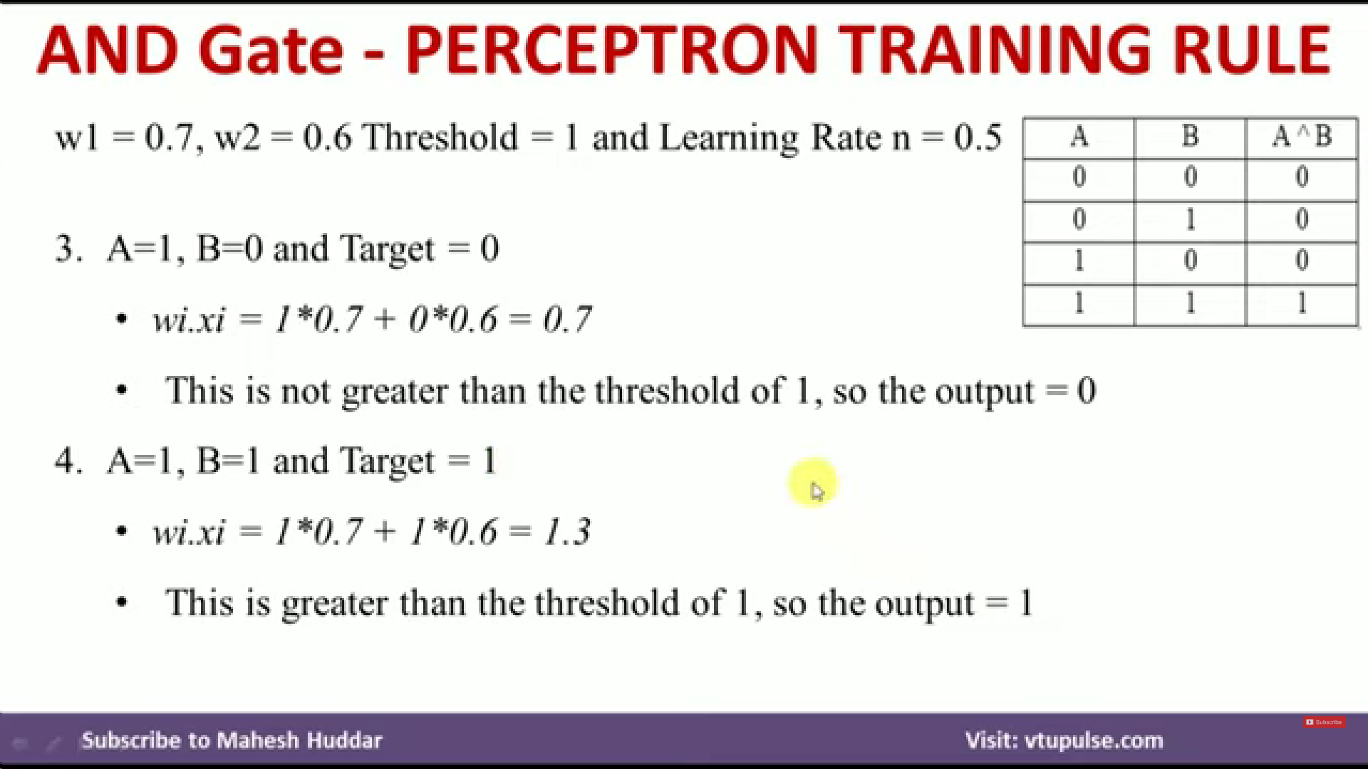
Therefore, we have classified all parameters properly w.r.t to target variables. These are the final learned parameters.
You can repeat the same process with OR and NOT gate w.r.t to OR and NOT table

Slide 7
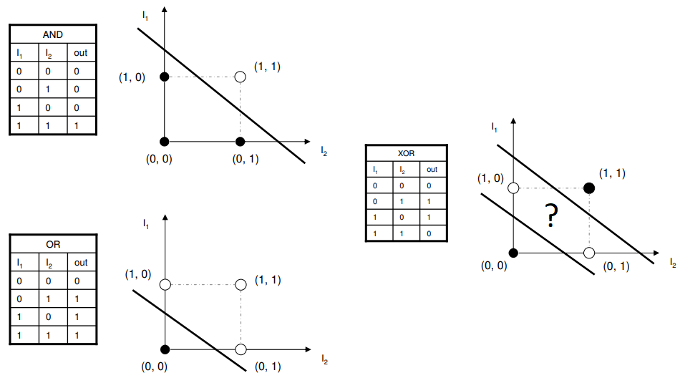
Linearly separable : AND, OR (single layer perceptron)
Non-linear : XOR (multiple layer perceptron)

Slide 8
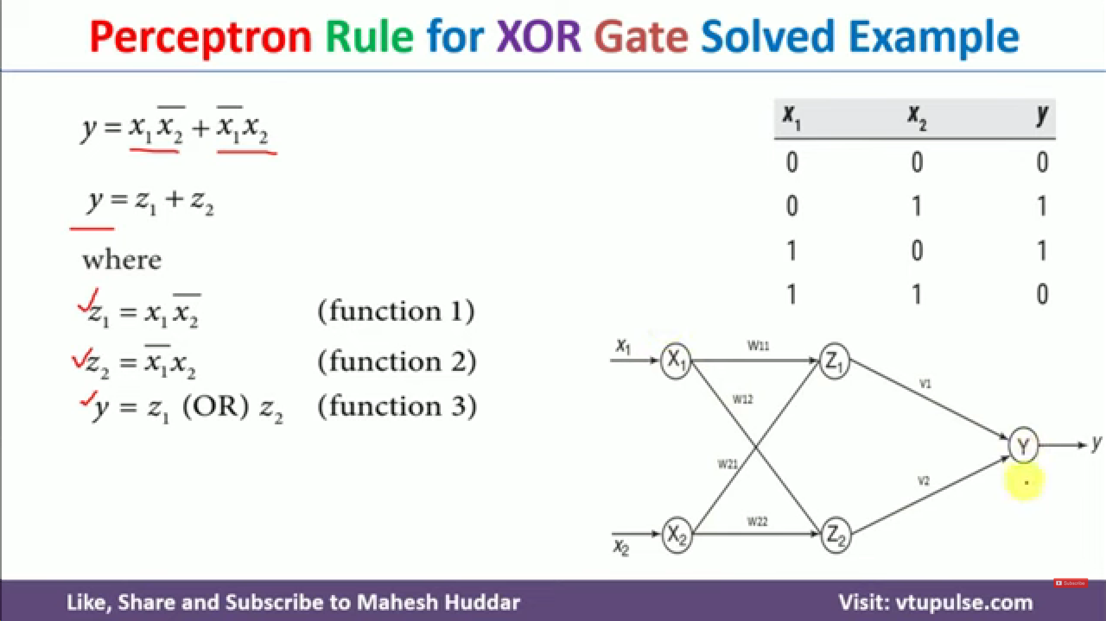
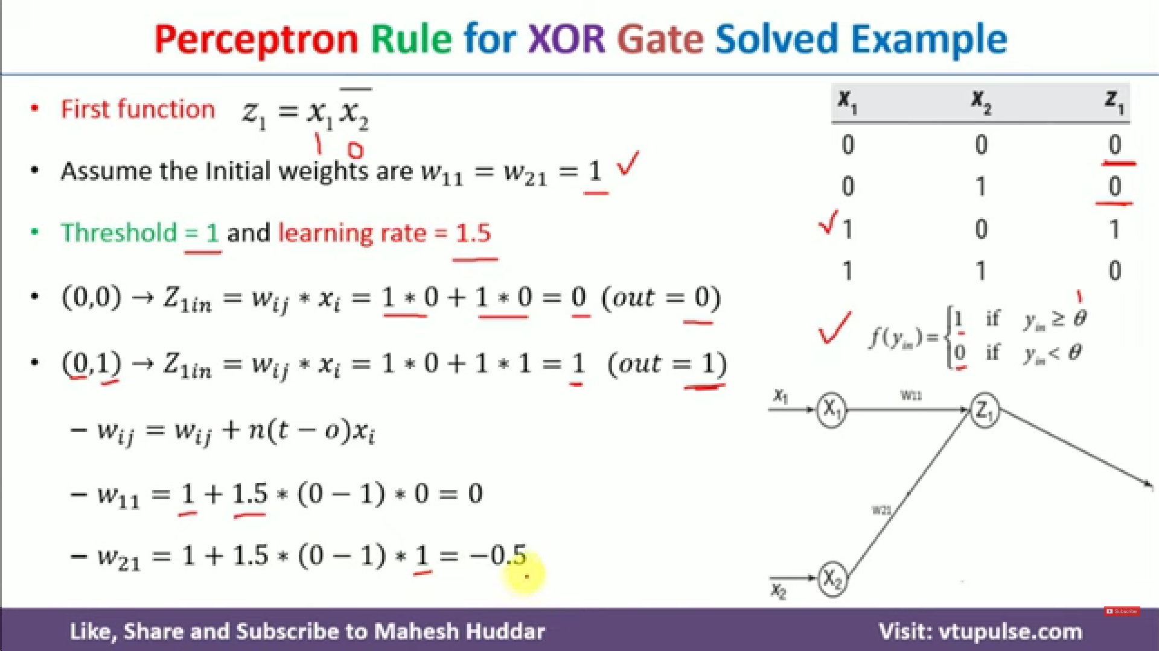
Corresponding truth table for z1

Slide 9
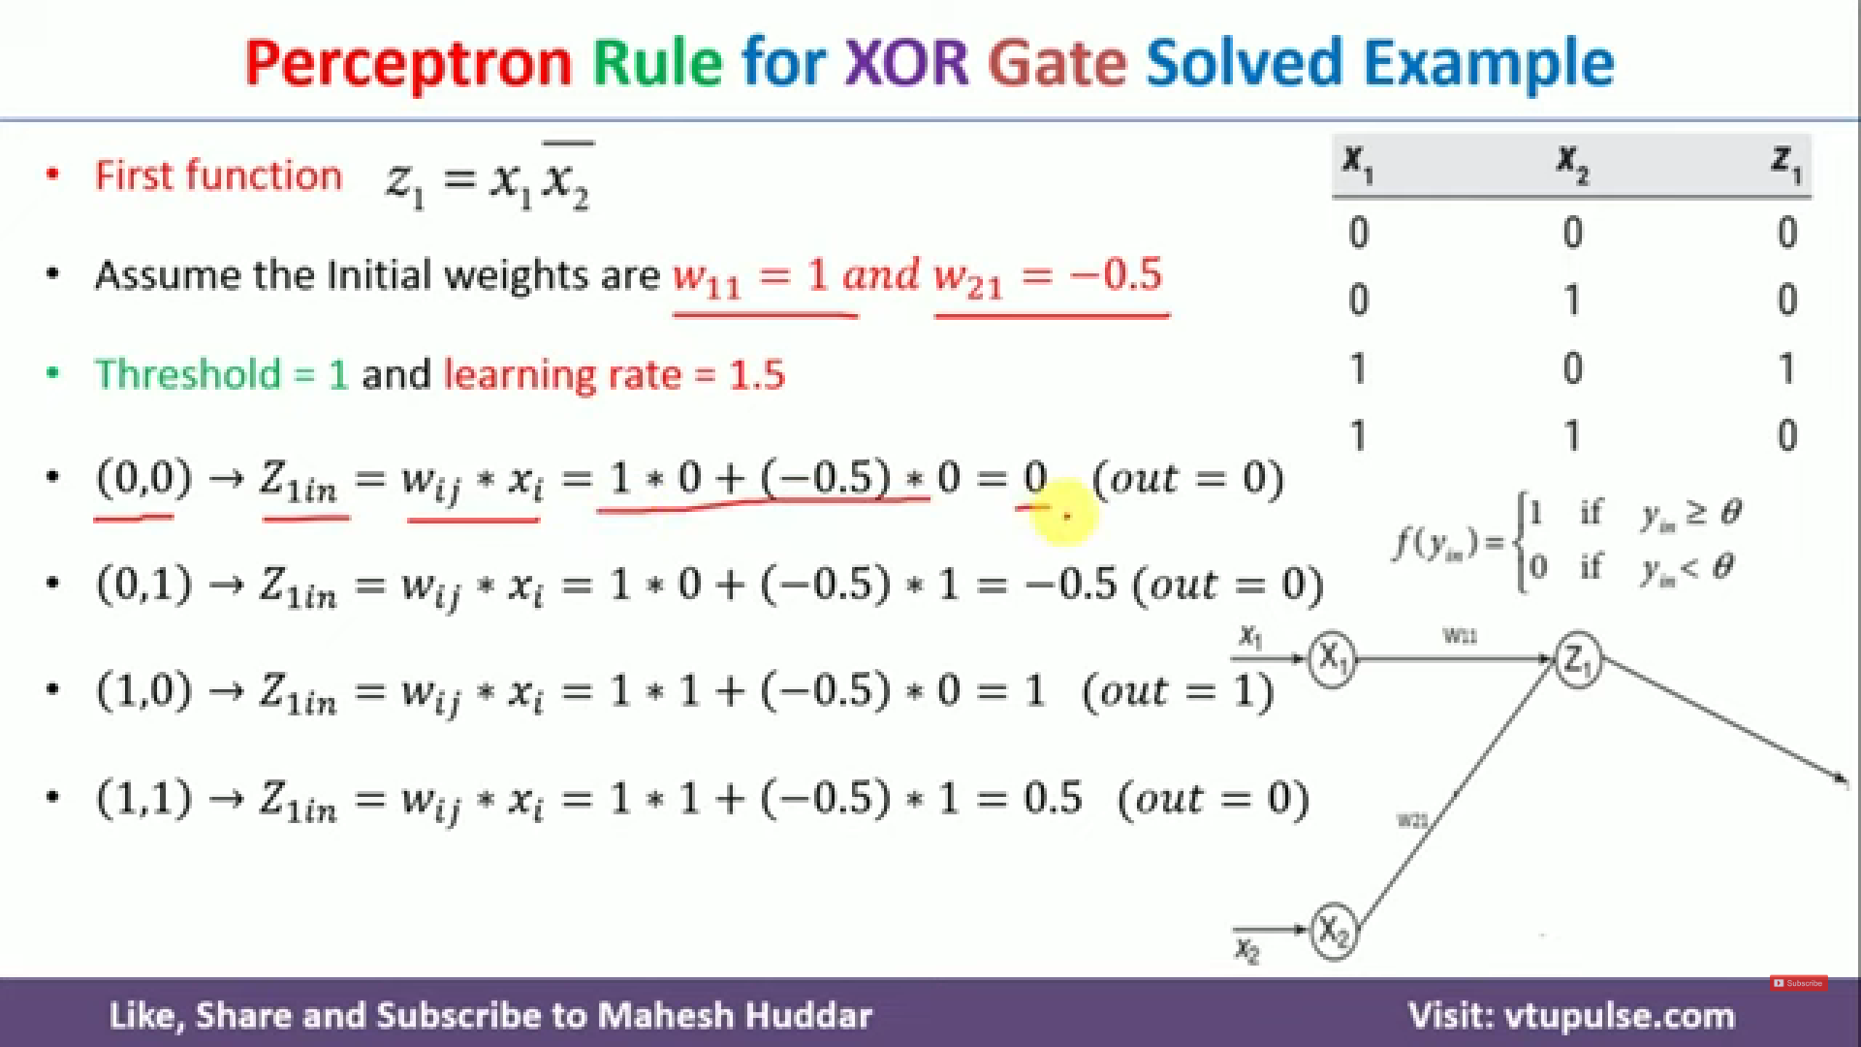
Since calculated output !=target output, we modify parameters

Slide 10
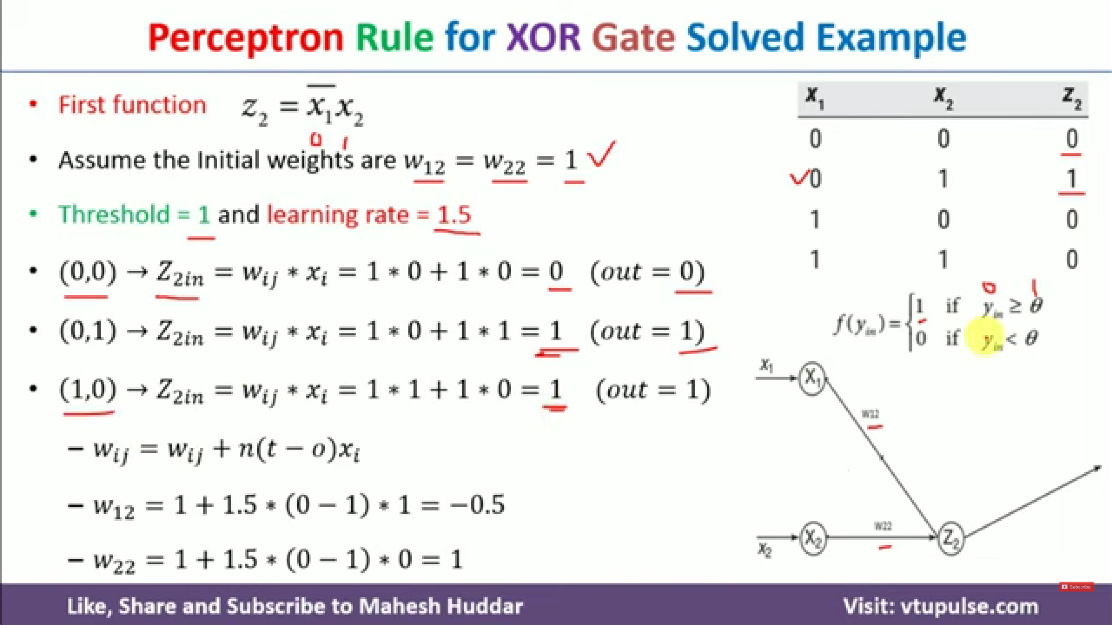
Second

Slide 11
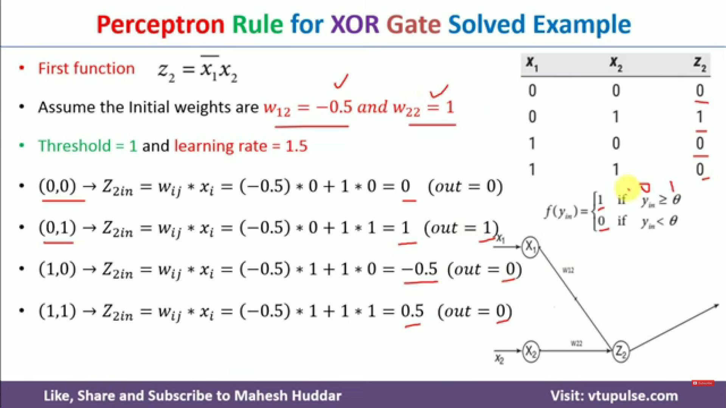
Second

Slide 12
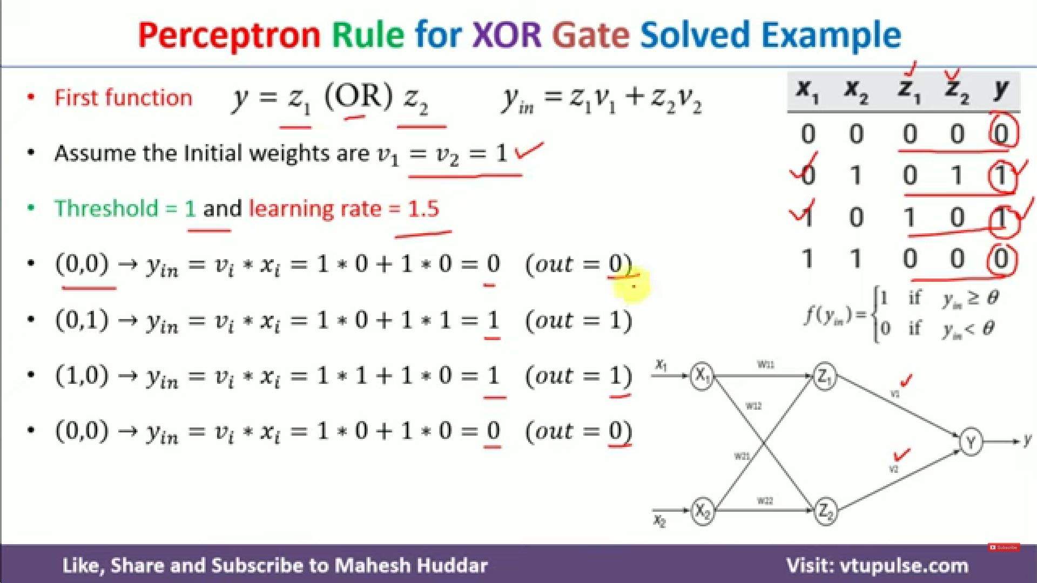
Final

Slide 13
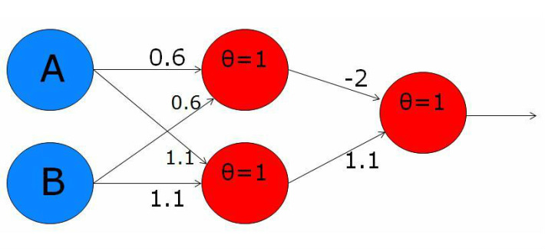
XOR with two-layer perceptron
Another configuration

Slide 14
MLP / Neural Network
A multilayer perceptron (MLP) is a perceptron that teams up with additional perceptrons, stacked in several layers, to solve complex problems.
Each perceptron in the first layer on the left (the input layer), sends outputs to all the perceptrons in the second layer (the hidden layer), and all perceptrons in the second layer send outputs to the final layer on the right (the output layer).

Slide 15
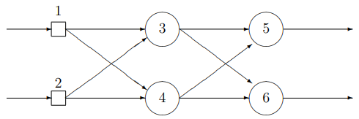
Exercise-2
What type of neural network it is (choose all those correct)
Single layer perceptron
Multi-layer perceptron
Feed-forward neural network
Fully-connected neural network
Number of hidden layers in the above network?
Number of weights to be learnt for this network?

Slide 16
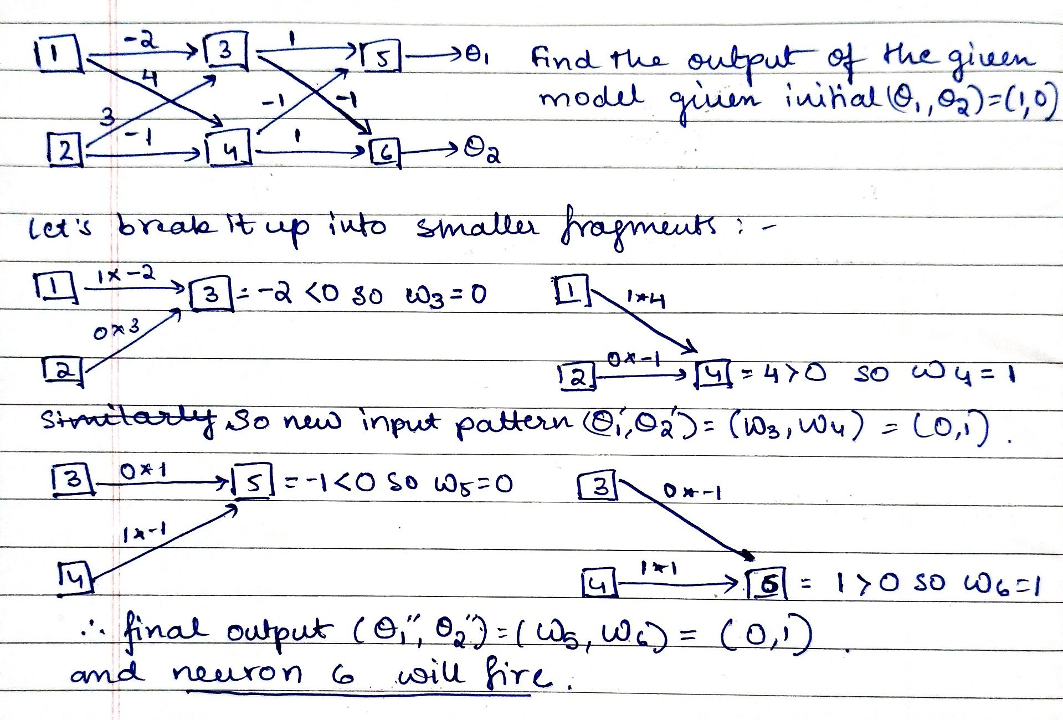

Slide 17
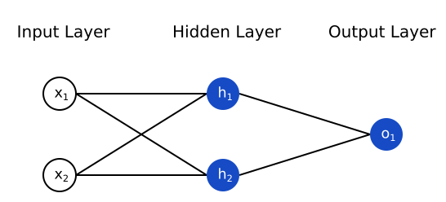
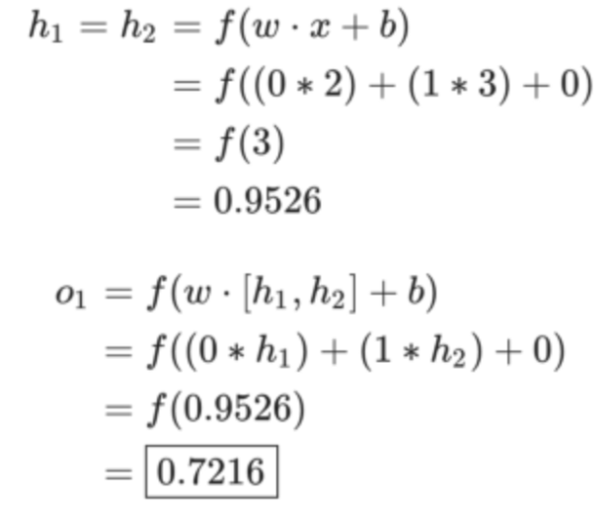
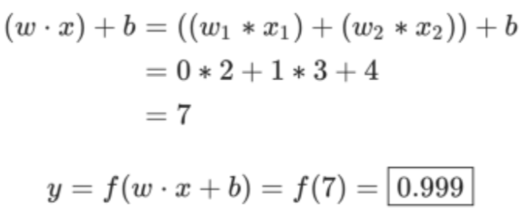
Exercise-3
w=[0,1], the bias b=0
sigmoid activation function
What happens if we pass in the input x=[2, 3]?
w=[0,1], the bias b=0
sigmoid activation function
What happens if we pass in the input x=[2, 3]?

Slide 18
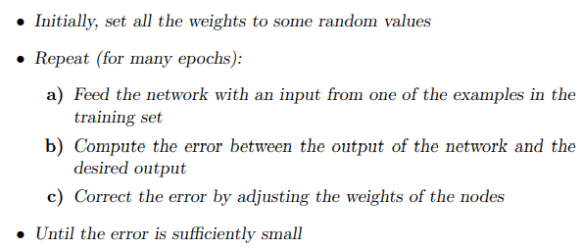
Perceptron Learning Algorithm

Slide 19
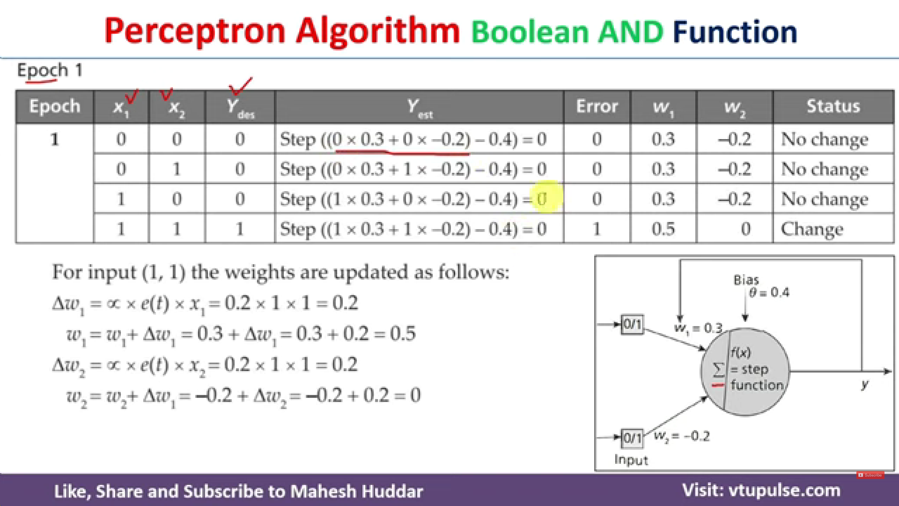













Step function will output 0 is result is –ve and 1 if result is +ve
Mismatch !
So error e =
Ydes – Yest =
1 – 0 = 1
Learning rate

Slide 20
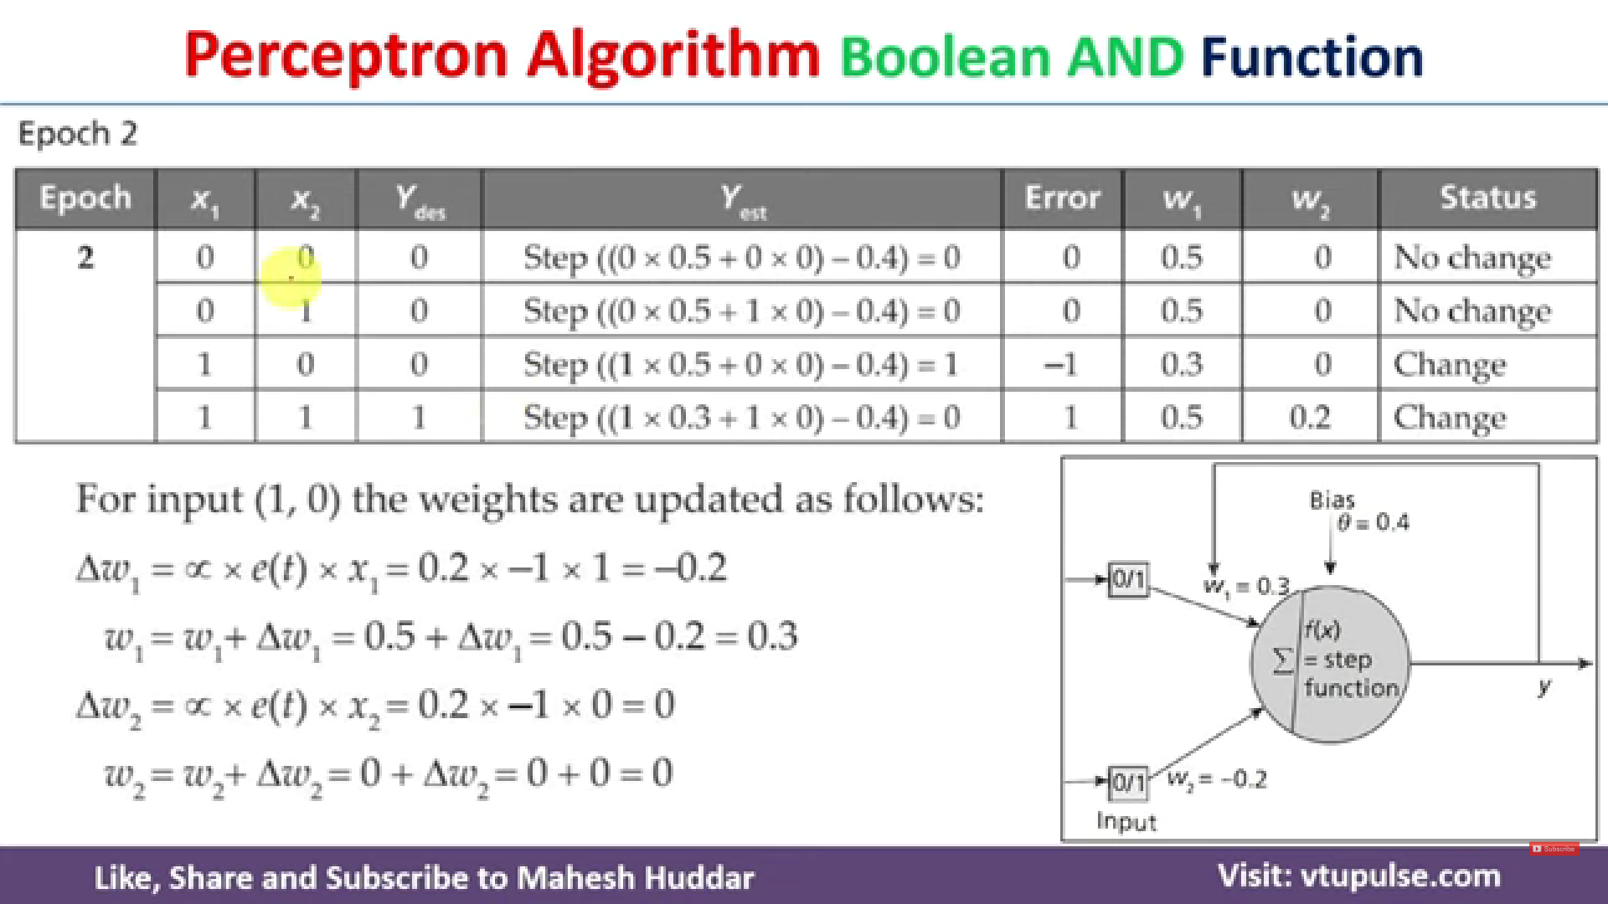







Mismatch !
So error e =
Ydes – Yest =
0 - 1 = -1
And 1 – 0 =1

Slide 21
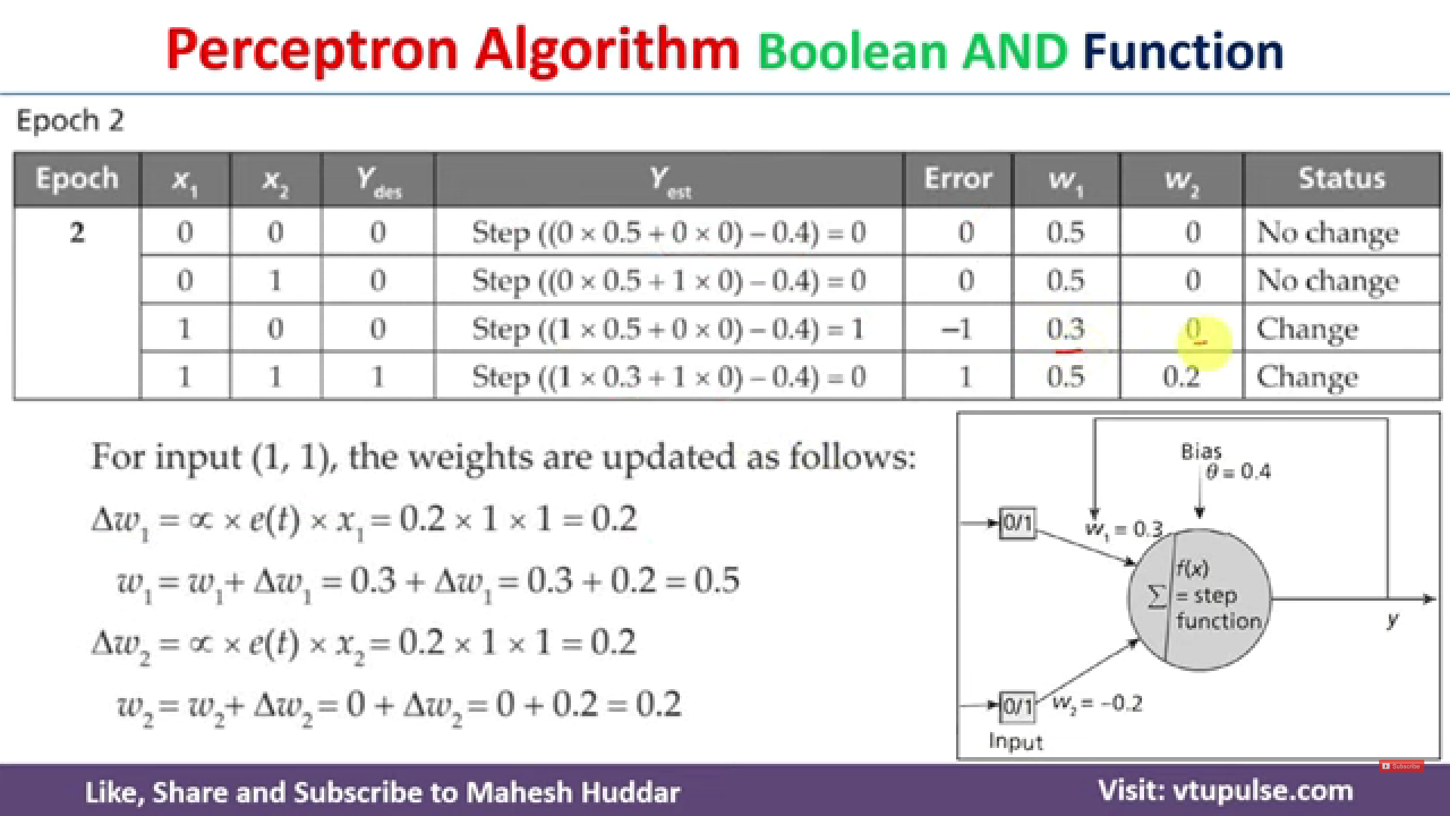





Slide 22
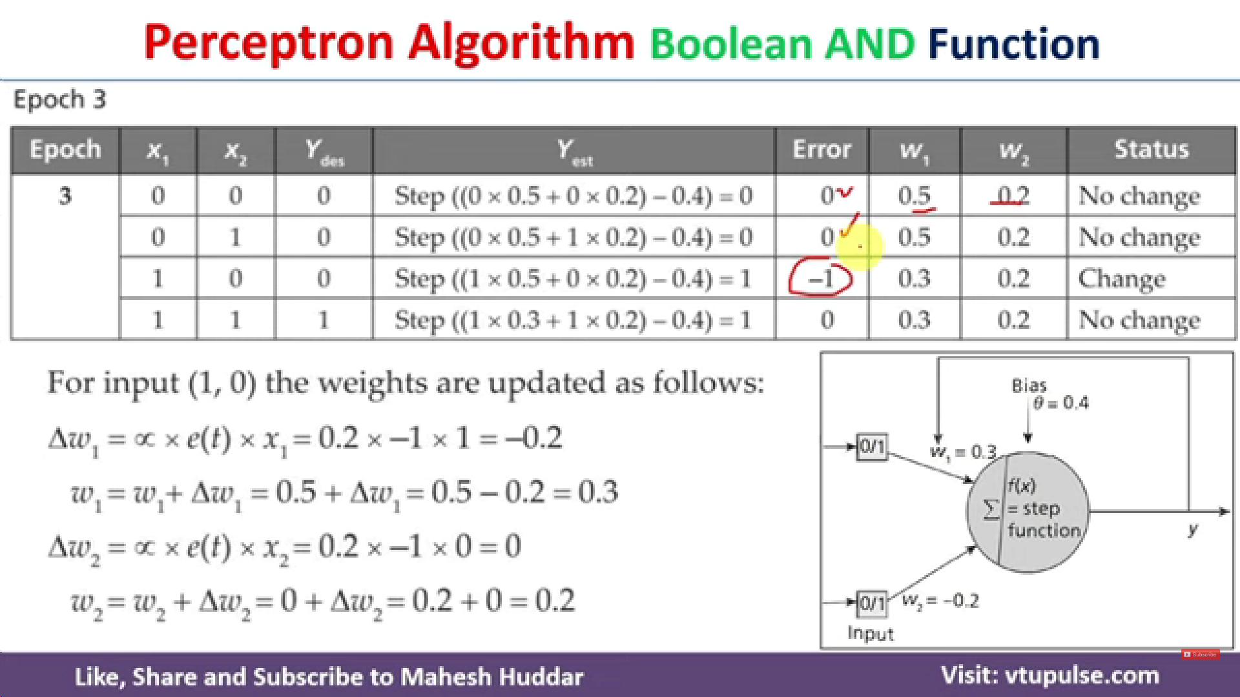





Slide 23
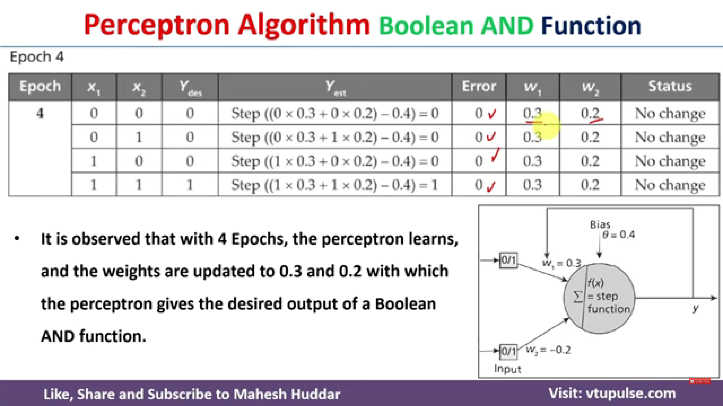

Slide 24
Perceptron Learning: Example-2
Consider learning the logical OR function.
Sample x0 x1 x2 label
1 1 0 0 0
2 1 0 1 1
3 1 1 0 1
4 1 1 1 1
Epoch | x0 | x1 | x2 | Desired Target | w0 | w1 | w2 | Output | Error | New w0 | New w1 | New w2
1 example 1 | 1 | 0 | 0 | 0 | 0 | 0 | 0 | 0 | 0 | 0 | 0 | 0
example 2 | 1 | 0 | 1 | 1 | 0 | 0 | 0 | 0 | 1 | 1 | 0 | 1
example 3 | 1 | 1 | 0 | 1 | 1 | 0 | 1 | 1 | 0 | 1 | 0 | 1
example 4 | 1 | 1 | 1 | 1 | 1 | 0 | 1 | 1 | 0 | 1 | 0 | 1
2 example 1 | 1 | 0 | 0 | 0 | 1 | 0 | 1 | 1 | -1 | 0 | 0 | 1
example 2 | 1 | 0 | 1 | 1 | 0 | 0 | 1 | 1 | 0 | 0 | 0 | 1
example 3 | 1 | 1 | 0 | 1 | 0 | 0 | 1 | 0 | 1 | 1 | 1 | 1
example 4 | 1 | 1 | 1 | 1 | 1 | 1 | 1 | 1 | 0 | 1 | 1 | 1
3 example 1 | 1 | 0 | 0 | 0 | 1 | 1 | 1 | 1 | -1 | 0 | 1 | 1
example 2 | 1 | 0 | 1 | 1 | 0 | 1 | 1 | 1 | 0 | 0 | 1 | 1
example 3 | 1 | 1 | 0 | 1 | 0 | 1 | 1 | 1 | 0 | 0 | 1 | 1
example 4 | 1 | 1 | 1 | 1 | 0 | 1 | 1 | 1 | 0 | 0 | 1 | 1
4 example 1 | 1 | 0 | 0 | 0 | 0 | 1 | 1 | 0 | 0 | 0 | 1 | 1
Output = b + w0x0 + w1x1 + w2x2
New w0 = α.E.x0
New w1 = α.E.x1
New w2 = α.E.x2

Slide 25
Neural Network – Supervised learning training
Perceptron learning algorithm - Applicable only for single layer perceptron
Backpropagation - Multi-layer supervised learning
The flow of computation:
Left-to-right (forward propagation) - computing the output of the network
Right-to-left (back propagation) - computing the gradients (or derivatives) of the weights in the network

Slide 26
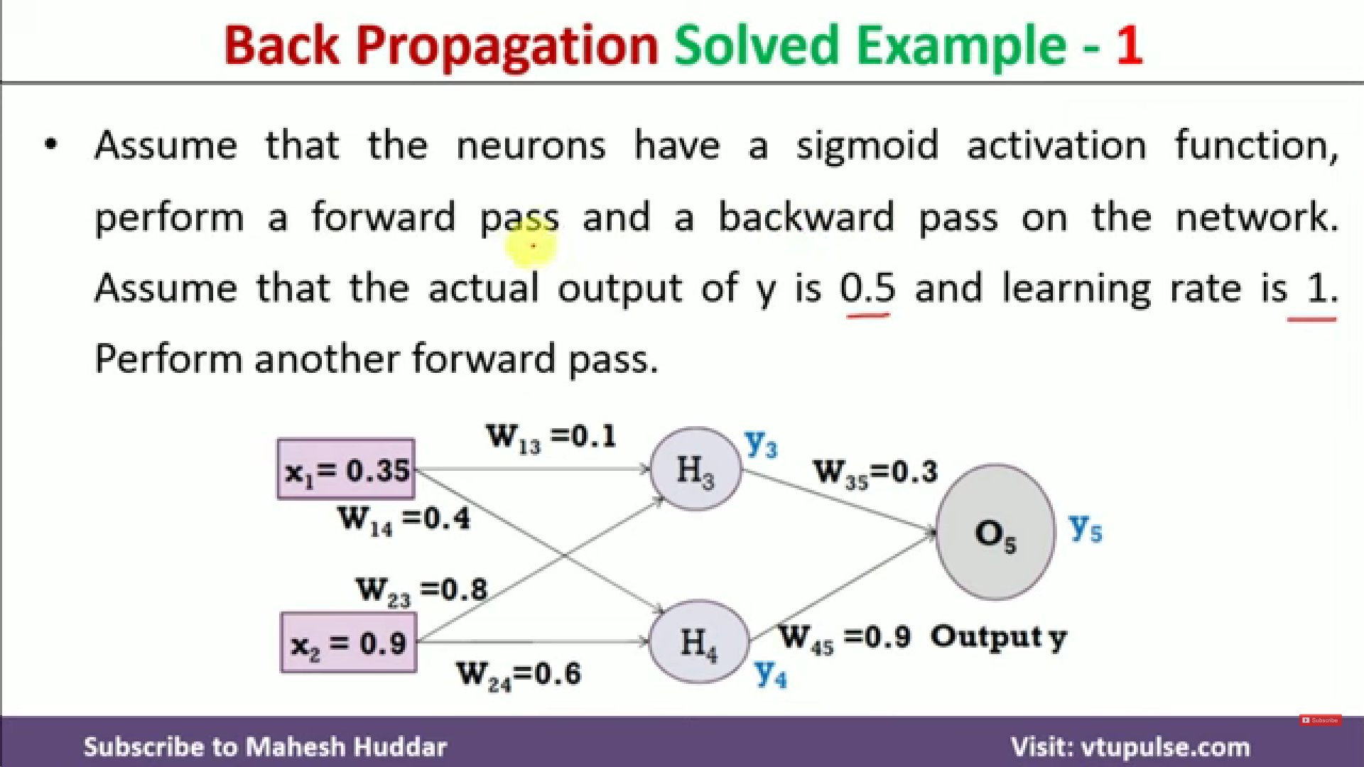

Slide 27
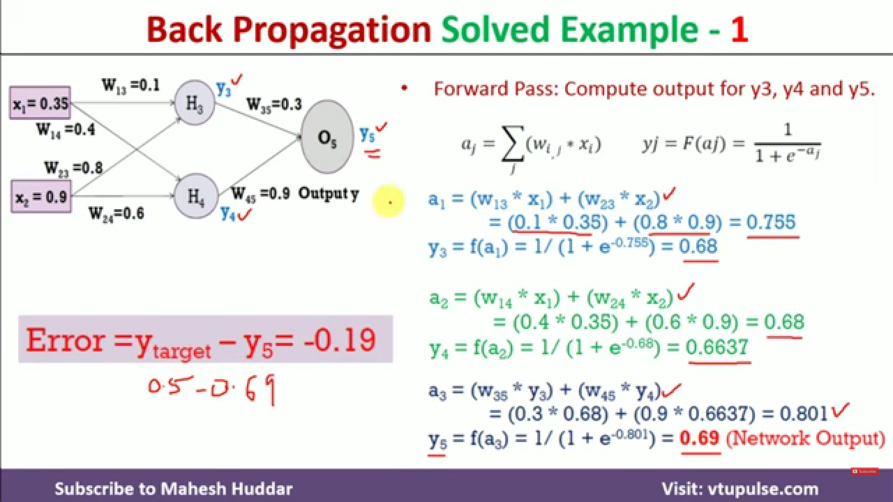
Activation Function
To remove error, we must modify weights

Slide 28
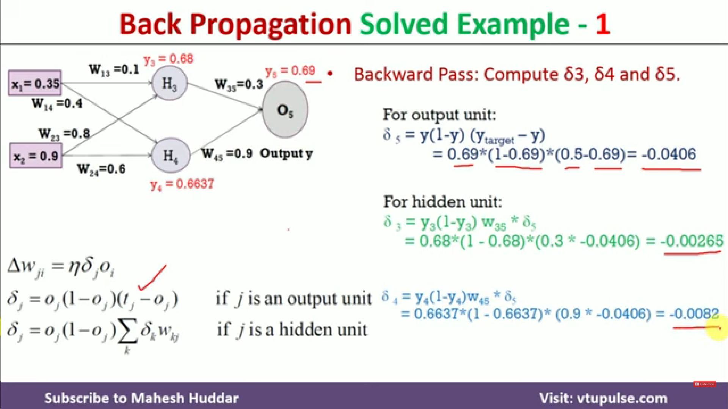
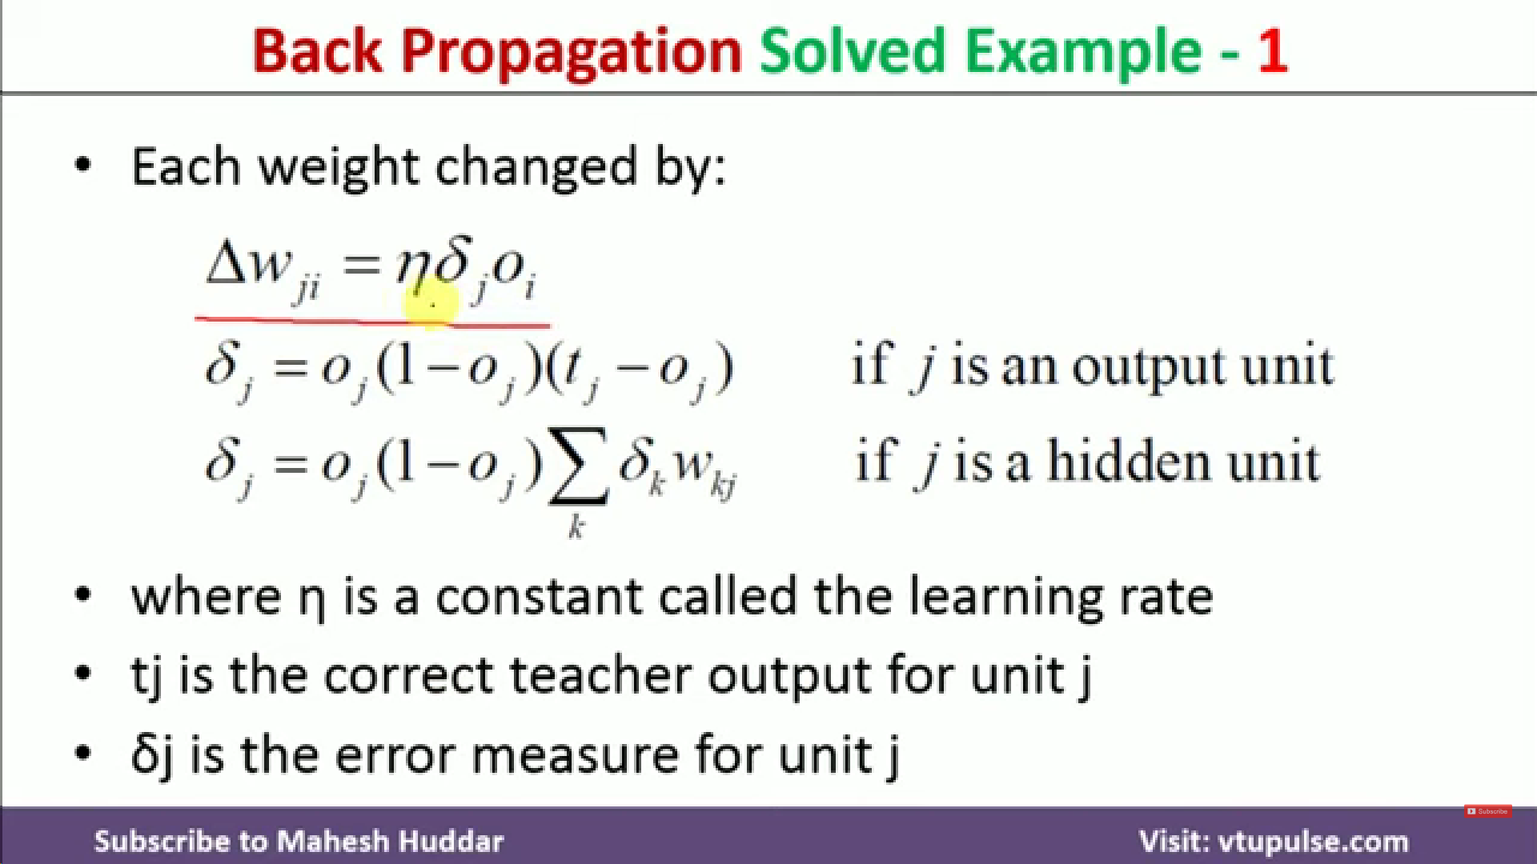

Slide 29
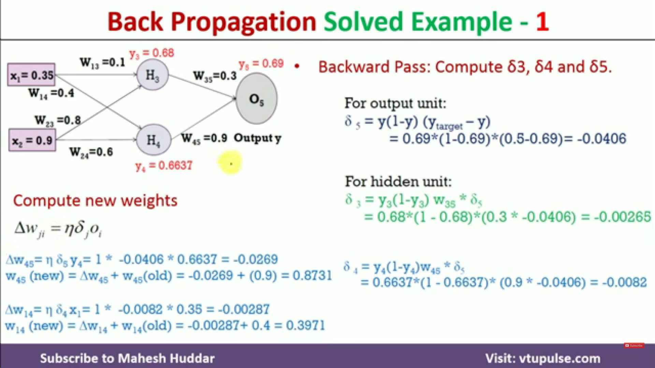
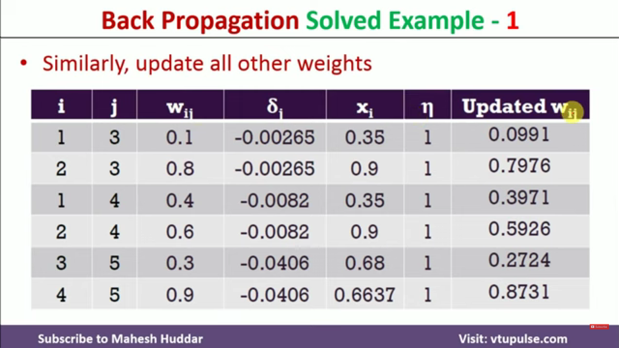

Slide 30
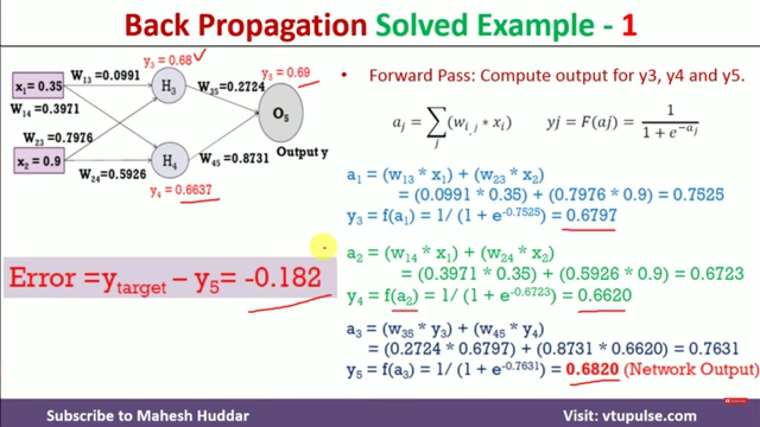
Update new weights in diagram
Keep repeating until error is 0 or negligible

Slide 31
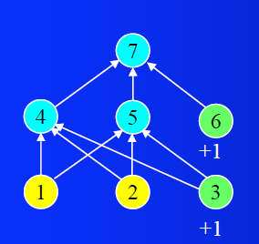
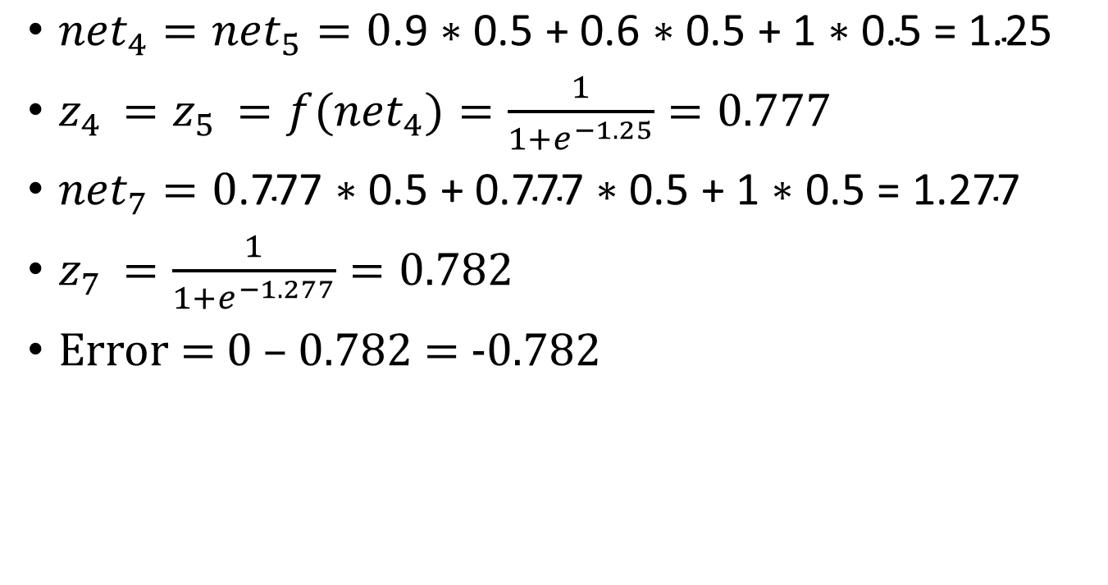
Example 2
Consider the following MLP. Assume all the weights in the network are initialized with 0.5. Assume a learning rate of 1. Show the updated weights after training on the pattern 0.9, 0.6 -> 0. Show all net values, activations, outputs, and errors.
${net}_{4}={net}_{5}=0\text{.9 ∗ }\text{0}\text{.5 + }\text{0}\text{.6 ∗ }\text{0}\text{.5 + 1 ∗ }\text{0}\text{.5 = 1.25}$
$z_{4 }=z_{5 }=f{(net}_{4})=\frac{1}{1+e^{−1.25}}=0.777$
${net}_{7}=0\text{.}\text{777}\text{ ∗ }\text{0}\text{.5 + }\text{0}\text{.}\text{777}\text{ ∗ }\text{0}\text{.5 + 1 ∗ }\text{0}\text{.5 = 1.2}\text{77}$
$z_{7 }=\frac{1}{1+e^{−1.277}}=0.782$
Error = 0 – 0.782 = -0.782

Slide 32
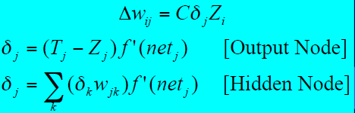
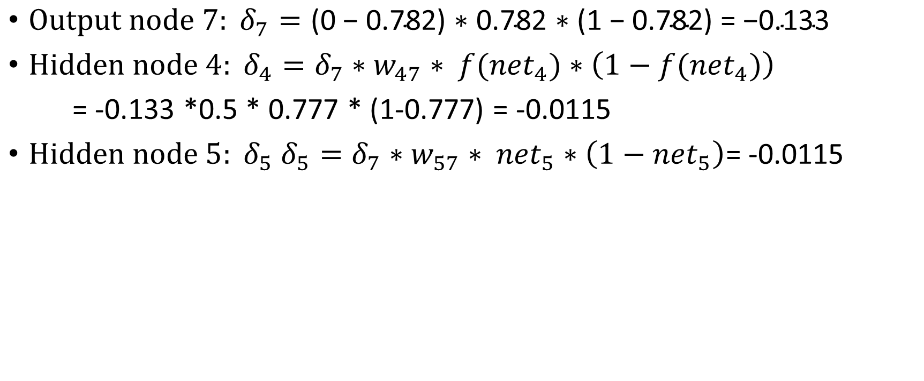
$\text{Output} \text{node}\text{ 7}: δ_{7}=\text{(0 − }\text{0}\text{.782) ∗ }\text{0}\text{.782 ∗ (1 }\text{−} \text{0}\text{.782) = −}\text{0}\text{.133}$
${\text{Hidden} \text{node} 4: δ}_{4}=δ_{7}{∗w}_{47} ∗ {f(net}_{4})∗\left(1−{f(net}_{4})\right)$
= -0.133 *0.5 * 0.777 * (1-0.777) = -0.0115
${\text{Hidden} \text{node} 5: δ}_{5} {δ_{5}=δ}_{7}{∗w}_{57} ∗ {net}_{5}∗\left(1−{net}_{5}\right)$= -0.0115
Update weights
w₁₄ = w₁₅ = 0.5 + (1 * -0. 0115 * 0.9) = 0. 4896
w₂₄ = w₂₅ = 0.5 + (1 * -0. 0115 * 0.6) = 0. 4931
w₃₄ = w₃₅ = 0.5 + (1 * -0. 0115 * 1) = 0.4885
w₄₇ = w₅₇ = 0.5 + (1 * -0.133 *0 .777) = 0.3964
w₆₇ =0 .5 + (1 * -0.133 * 1) =0.3667

Slide 33
Exercise
Design a MLP ANN architecture for realizing logical XOR function.
Assume all the weights are initialized with 0.2 and learning rate is 0.5.
show the updated values for all the weights after 1 epoch for the input <0, 1>

